Slide 1
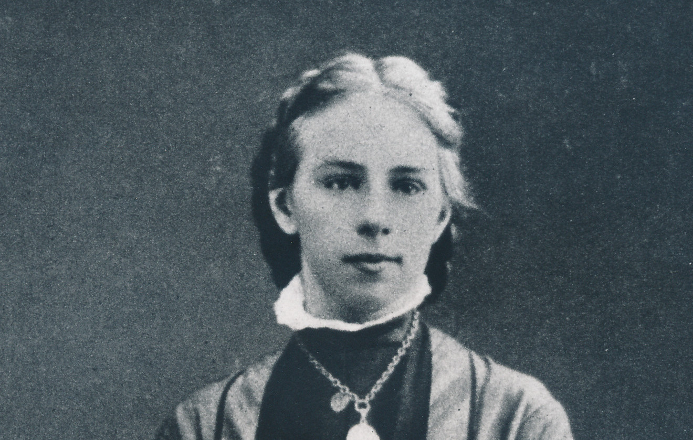




Emilie
Team Emilie:
Ana R. Correia
Karin Sim
Sanaz Reinhardt
Sirinya Richardson
Yaiza Aragonés Soria
Emilie Kempin-Spyri, circa 1885
First woman in Switzerland to graduate with a law degree and to be accepted as an academic lecturer.

Slide 2

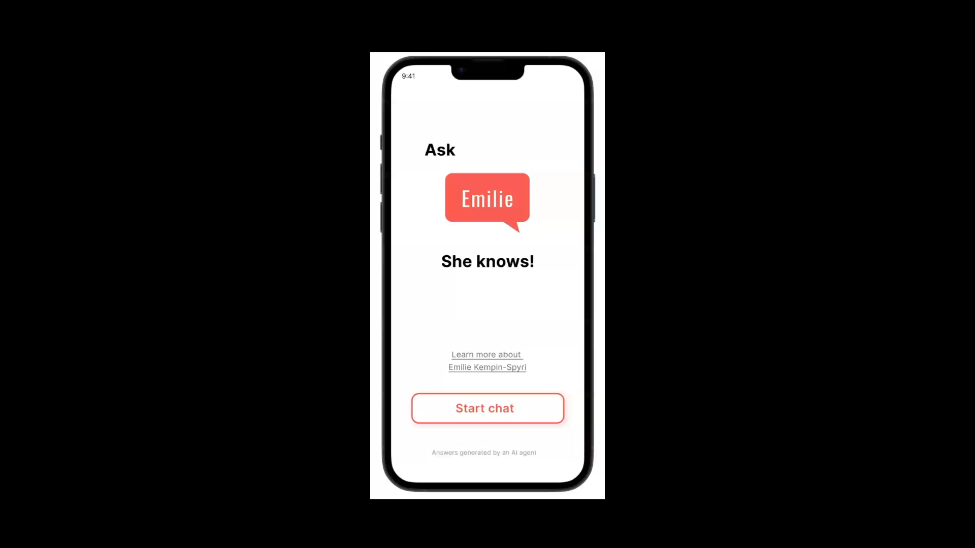

Slide 3
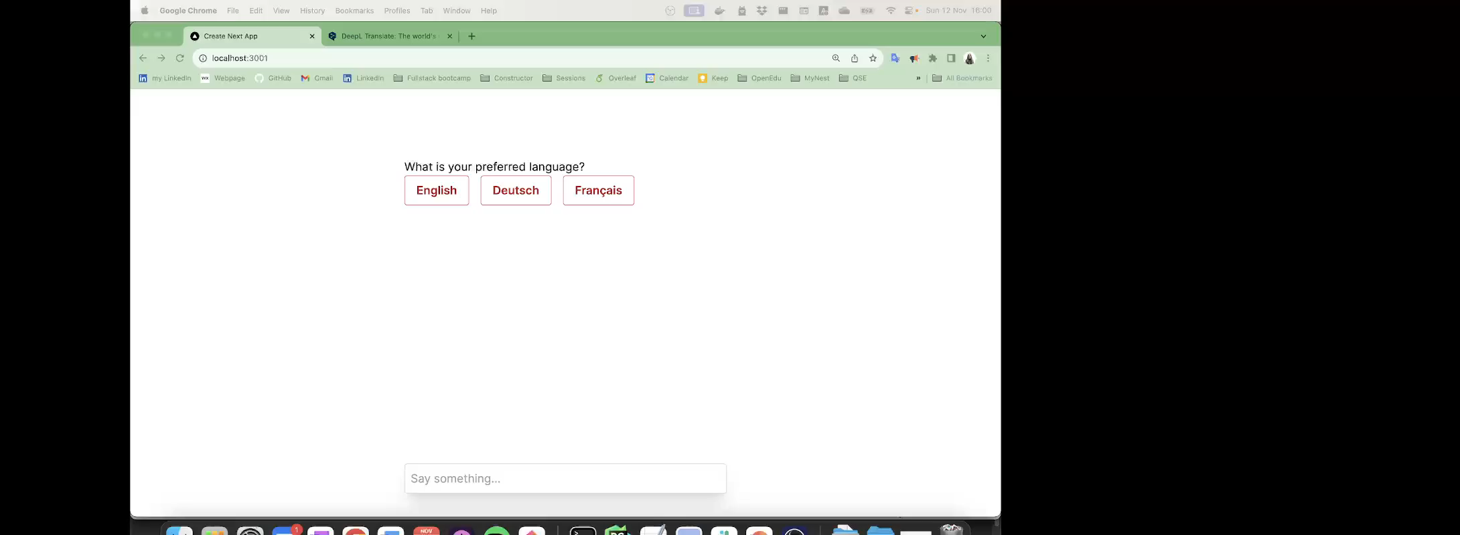
From the onboarding the user selects:
Language
Canton
Level of Swiss Law
Familiarity
Allows the delivery of a tailored, accessible and relevant summary of legal information

Slide 4
Designed Features:
Design with high contrast
Onboarding
3 languages from the get-go
Direct links to relevant articles
Option to save the conversation
Fresh conversation at any point
Notes:
Design interface with high contrast to increase readability for users with diverse visual capacities;
Onboarding improves users experience and improves chat’s retrieved results;
Option to select between 3 language from the get-go (by omission conversation and results will be in English);
Tailored and relevant information is retrieved;
Direct links to the relevant articles (in the selected language) are incorporated in Emilie’s response;
Option to save conversations:
Storing the retrieved references
Resume conversation later on
The user can at any point start a fresh new conversion.

Slide 5
Next Steps:
Improve Empathy
Improve Accessibility
Enhance onboarding
Evaluate and minimize potential biases
Option between detailed info vs summary
User testing
Notes:
Improve the chatbot Empathy;
Improve accessibility by:
Supporting more languages
Integrating speech recognition and ultimately the ability do have a videobot
Enhance onboarding;
Guide the user to access more information by providing suggestion of questions;
Allow the user to select the level of information provided (more detailed vs summarized version);
Evaluate and minimize potential biases;
User testing to validate all implementations.

Slide 6
